Slide 1
City of Greeley
Stormwater Board Meeting
June 8, 2022
Meeting Location:
1001 11th Avenue, Room 227, 4:30 p.m.

Slide 2
Stormwater Board Agenda
June 8, 2022, 4:30 PM
1001 11th Avenue, #227
    Call to Order
    Roll Call
    Changes to the Agenda & Announcements
    Introductions of new board members & staff
    Presentation of new Board Binders
    Approval of April Minutes
    Budget Update Karen Reynolds / Purpose: Information
    12th Street Outfall Project Andrew Fisher / Purpose: Informational
    Adjournment

Slide 3
Changes to the Agenda & Announcements
Call to Order
Motion:___________ Second:___________
Roll Call
Jerrod Carlson - Chair
Casey Phythian – Vice Chair
Paul Henneck
Phillip Taylor
James Freville

Slide 4
Introduction of New Board Members & Staff
Presentation of new Board Binders
Phillip Taylor - appointed March 2022
James Freville – appointed May 2022
Bhooshan Karnik – Deputy Director of Public Works
Binder Presentation and Discussion
Approval of April Minutes
Motion:__________ Second:___________

Slide 5
2022 Revenue As of May 31st (Does not include the $17M bond revenue)
Fund | Sum of Budget | Sum of YTD Receipts | Sum of Balance | % of Budget Received to Date
Stormwater Operations | 3,270,754 | 1,336,501 | 1,934,253 | 40.86%
Stormwater Construction | 18,118,405 | 1,016,760 | 17,101,645 | 5.61%
Stormwater Replacement | 2,332,987 | 878,765 | 1,454,222 | 37.67%
Grand Total 41.67% / 100% | $ 23,722,146 | $ 3,232,026 | $ 20,490,120 | 13.62%
2022 Expenditures
Fund | Sum of Budget | Sum of YTD Expenses | Sum of Balance | % of Budget Spent to Date
Stormwater Operations | 3,446,468 | 783,436 | 2,663,032 | 22.73%
Stormwater Construction | 17,169,573 | 962,046 | 16,207,527 | 5.60%
Stormwater Replacement | 2,658,809 | 1,071,482 | 1,587,327 | 40.30%
Grand Total 41.67% / 100% | $ 23,274,850 | $ 2,816,964 | $ 20,457,886 | 12.10%
Stormwater Accounts added in 2022: 109 as of March 31

Slide 6
12th Street Outfall

Slide 7
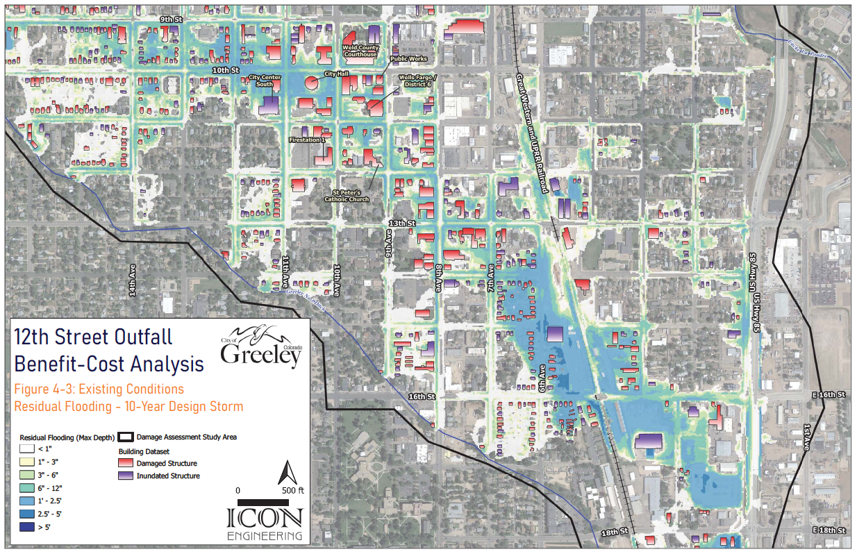
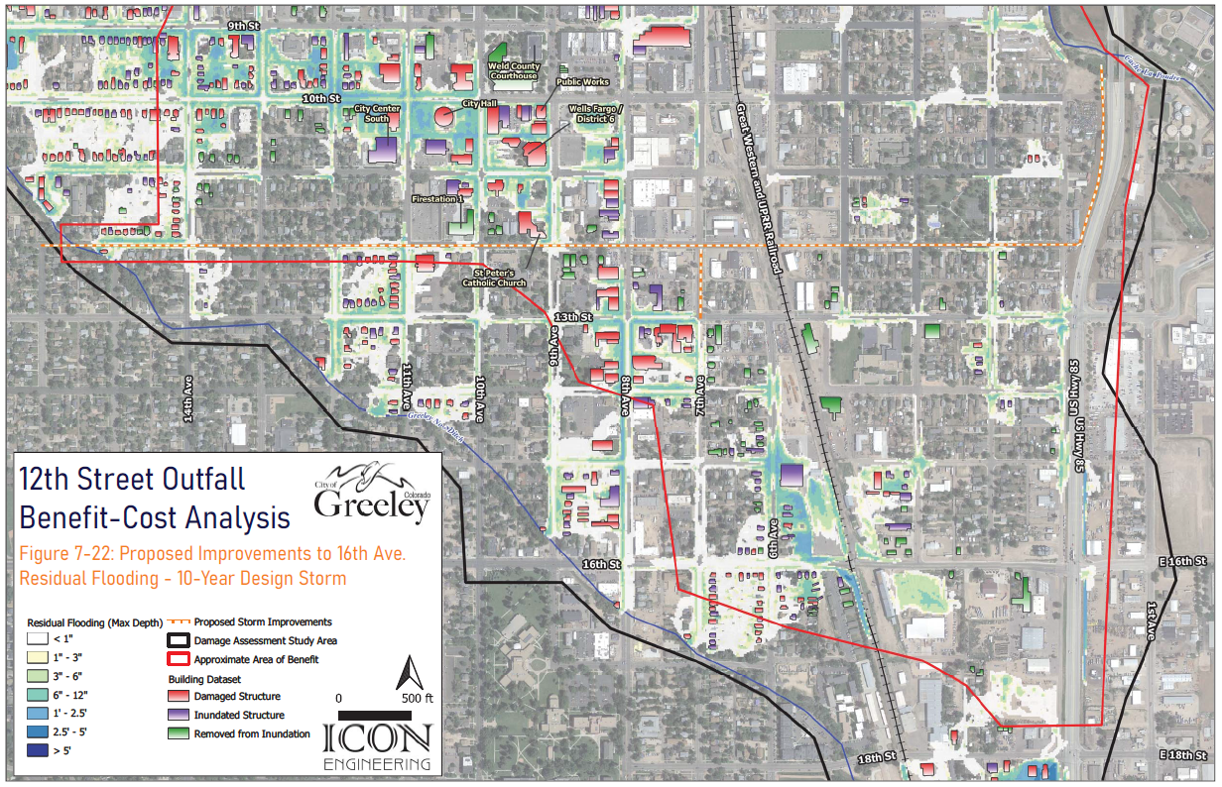
12th Street Storm Outfall Phase 1
Existing
Phases 1-7 Completed (2032)

Slide 8
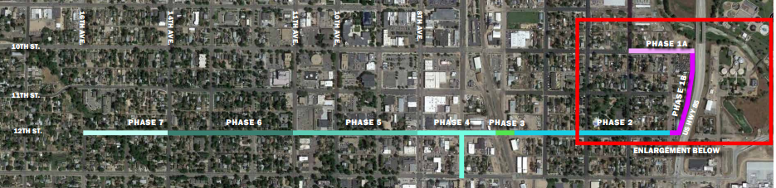
12th Street Storm Outfall Phase 1

Slide 9
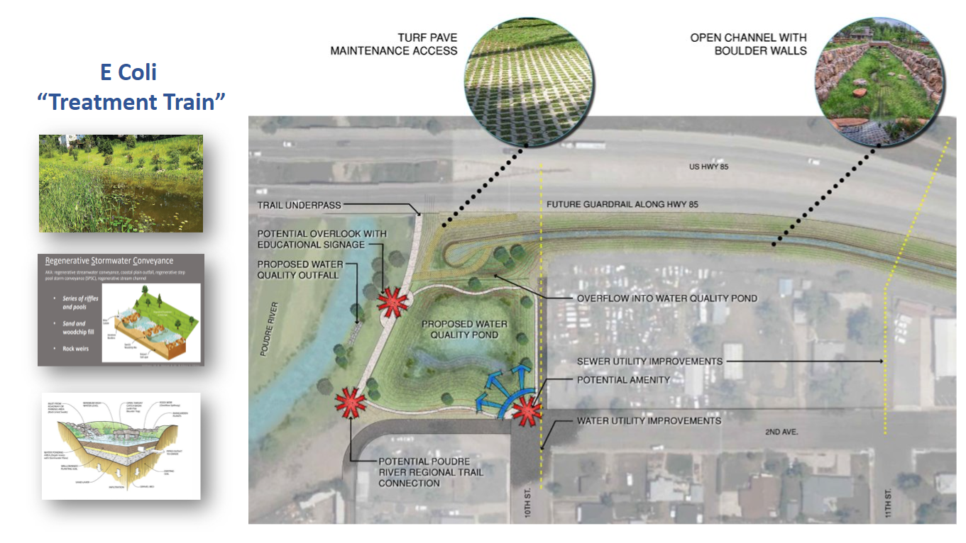
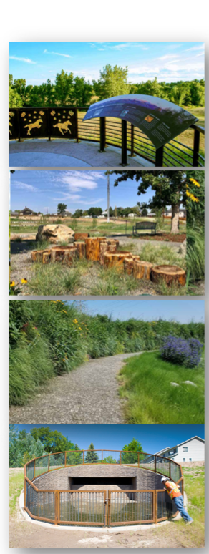
12th Street Storm Outfall Phase 1
N
WATER
SEWER

Slide 10

12th Street Storm Outfall Phase 1
PRECONSTRUCTION SCHEDULE
March 2022 – Hired Connell Resources for Preconstruction Services through competitive proposals
July – 90% Design Completed
September – Construction Contract
October – Notice to Proceed

Slide 11
12th Street Storm Outfall Phase 1
DRAFT CONSTRUCTION SCHEDULE*
October – 3rd Ave/9th Street, 2nd Ave/11th Street, Begin Utility Work and Pond Excavation
Dec-Jan - Outfall to River
Feb-March 2023 – 2nd Ave/10th Street
Mar-June 2023 – Box Culvert and Open Channel
May-Aug 2023 – Final Pond grading and landscaping
Winter 2023-24– River Restoration
*subject to change
NOTE: Phase 2 and 3 Design RFP in early 2023

Slide 12
12th Street Storm Outfall Phase 1
BUDGET
$17 M bond executed in March 2022
Awarded $0.25 M FEMA grant for design in January
$299k Design Change Order City Council June 7 for:
  E. Coli Water Quality Improvements (Regulatory)
  Enhanced River Restoration (Reduction of future maintenance)
  Preconstruction Services (Reduction of construction risk and cost)
Project is currently under budget

Slide 13
Questions?
Adjournment
Motion:___________ Second:___________

